Slide 1
IoT based forest fire prediction system using fuzzy logic
GUIDED BY
Mr.V.Sivamurugan
Associate Professor
PROJECT BY
Archan Rajaram Ramadevi
IT-A
312215205017
Harshini.M
IT-A
312215205031

Slide 2
Objective
To predict the occurrences of forest fire.
To collect the physical environmental parameters of the forest through sensors using IoT.
To classify the occurrence of forest fire based on the intensity and use fuzzy logic to express the chance of occurrence of forest fire in percentage.

Slide 3
Existing system
The current satellite-imagery-based forest fire detection systems cannot detect forest fires with high precision and accuracy.
In order to prevent forest fire efficiently, we need a highly intelligent system to predict the forest fire at a higher speed and accuracy automatically.

Slide 4
Proposed system
To predict the forest fire based on the sensor values.
To classify it based on the values of different parameters such as temperature, smoke,flame as mild,moderate, severe or No Forest Fire.
An application is designed to display the sensor readings and the result of the classification.
The proposed system will also use fuzzy logic rules to express the chance of occurence of the forest fire in percentage in the near future.

Slide 5
Requirements
Hardware:
NODE MCU (Microcontroller)
Temperature sensor LM35
Smoke sensor MQ2
Flame sensor
Buzzer (Active)
Software:
Arduino IDE
Android Studio
Hive MQ

Slide 6
Literature Survey
Forest fire prediction and alert system using wireless sensor network
The sensor module consists of multiple sensors like temperature sensor, humidity sensor, etc.
They collect the target environment information and continuously transfer it to the control center where the necessary process is carried out.
It uses Zigbee which is a specification for communication in a wirelesspersonal area network (WPAN). Zigbee is based on an IEEE 802.15 standard. Itconsumes low power with transmission distance of 10 to 100 meters line of sight.

Slide 7
Literature survey Contd..
When the temperature in a particular node gets increased over a fixed threshold value then the alert is sent to the control center and the neighbouring nodes.
Sensor nodes are less costly and even if it gets damaged in fire it won’t be a great loss. Using GPS the exact location of the fire can be easily obtained and the nearest fire service can be easily informed using GSM.
The rate of spread of forest fire is calculated as

Slide 8
Forest Fire Detection Through Various Machine Learning Techniques using Mobile Agent in WSN
Review of machine learning techniques for detection of forest fire are given below:
Support Vector Machine(SVM)
Artificial Neural Network(ANN)
Decision Tree(DT)
Feed Forward Neural Network (FFNN)

Slide 9
Support vector Machine
SVM belong to the class of supervised learning algorithms in which the learning machine is given a set of examples (or inputs) with the associated labels (or output values).
SVMs construct a hyperplane that separates two classes.

Slide 10
Artificial Neural Network
The Artificial neural networks are kind of learning based algorithms.
These basically work on principle of neuron. The first model of neuron contained two inputs and one output. Both the inputs should be active for correct output. The weights for both the inputs were equal and output was binary.

Slide 11
Decision tree
Decision tree classify instances by sorting them down the tree from the root to some leaf node.
The final result is a decision tree in which each branch represents a possible scenario of decision and its outcome.

Slide 12
Feed Forward Neural Network
The inputs feed into a layer of hidden units, which can feed into layers of more hidden units, which eventually feed into the output layer.

Slide 13
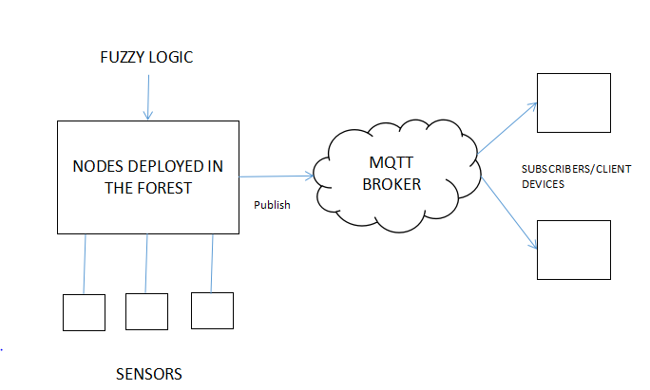
System Design workflow

Slide 14
System Architecture
SENSORS
Node MCU
MQTT broker
WIFI
NODE MCU
SENSORS

Slide 15
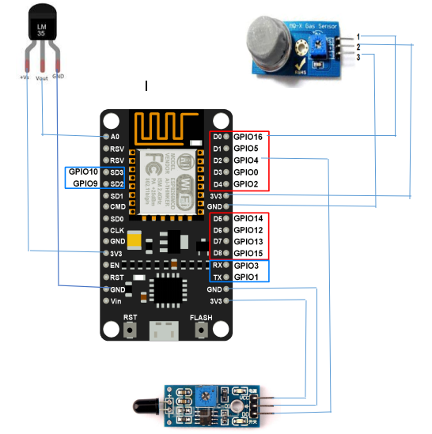
Sensors connected to the Node MCU

Slide 16
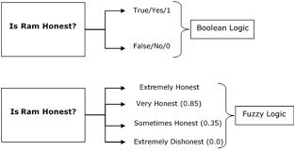
Fuzzy logic
In Boolean system truth value, 1.0 represents absolute truth value and 0.0 represents absolute false value.
But in the fuzzy system, there is no logic for absolute truth and absolute false value. But in fuzzy logic, there is intermediate value too present which is partially true and partially false.

Slide 17
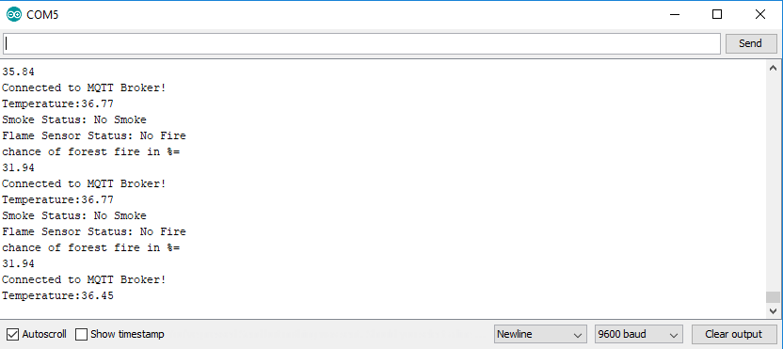
The serial monitor of the Arduino IDE having the sensor readings and the result status

Slide 18
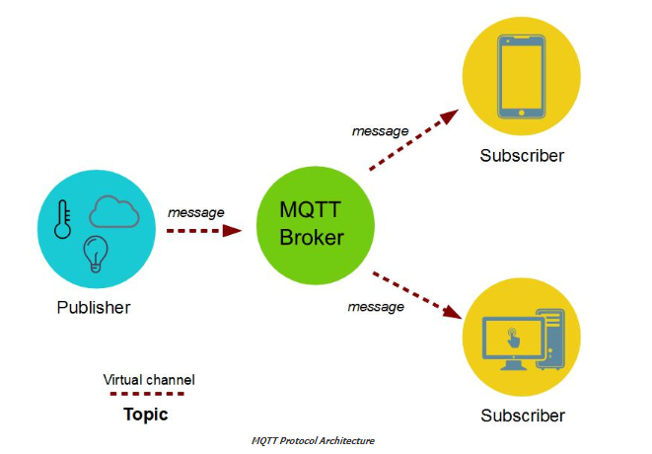
MQTT Protocol Architecture

Slide 19
Publishing data from NodeMCU to MQTT broker in different virtual channels(Topic)
Code snippet:
//MQTT TOPICS
const char* temperature="archan/temperature";
const char* gas="archan/gas";
const char* flame="archan/flame";
const char* status1="archan/status";
const char* prob="archan/prob";
Hive MQ is the online MQTT broker used in this project while Raspberry PI could also be programmed to function as a local MQTT broker.

Slide 20
Displaying Output
The values published to the MQTT broker can be displayed in an app.
These values will be used to classify the forest fire as no forest fire, mild, moderate and severe and also the chance of occurence in percentage and the result is also displayed in the app.

Slide 21
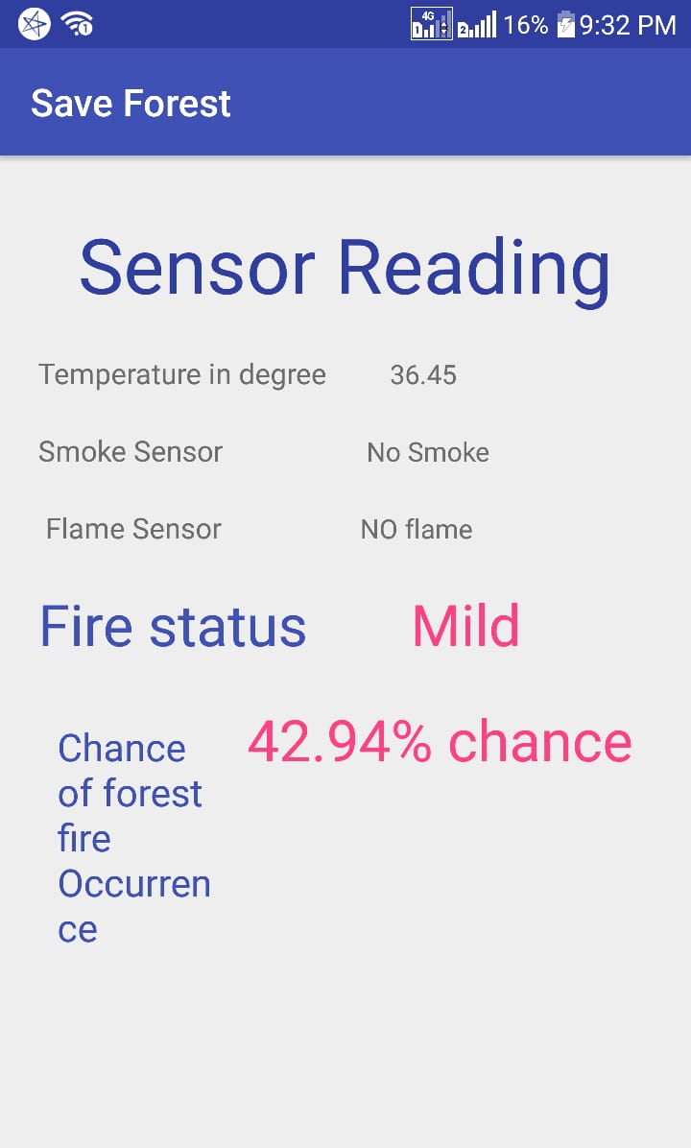
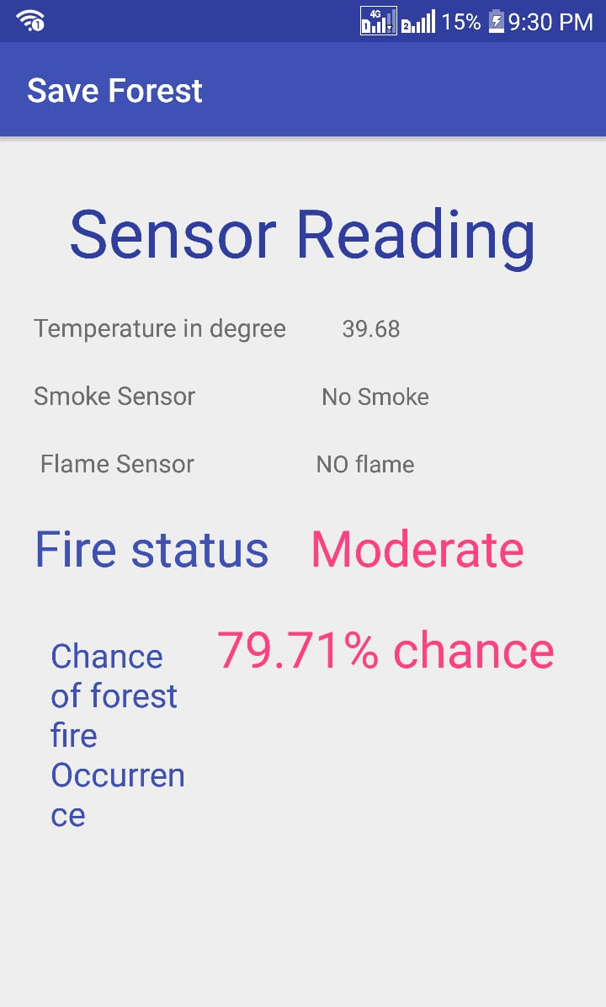
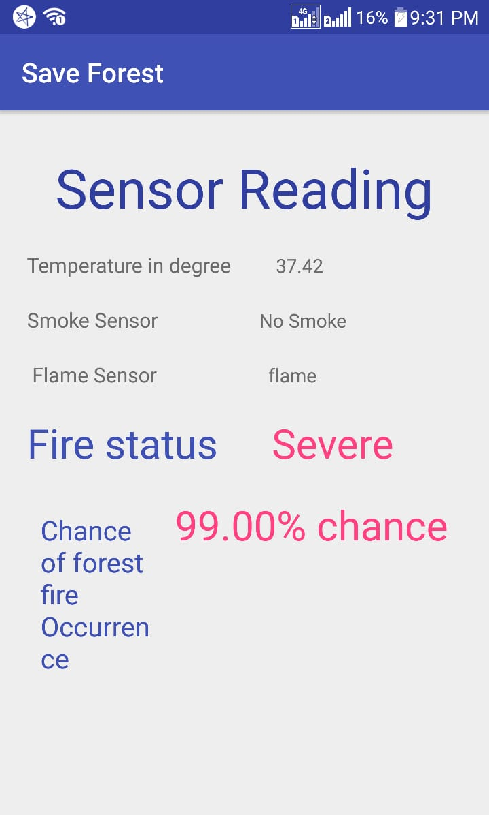
Results

Slide 22
References
[1] A. Chauhan, S. Semwal and R. Chawhan, "Artificial neural network-based forest fire detection system using wireless sensor network," 2013 Annual IEEE India Conference (INDICON), Mumbai, 2013, pp.16,doi:10.1109/ INDCON.2013.6725913
[2] Anupam Mittal, Geetika Sharma, Ruchi Aggarwal, “Forest Fire Detection Through Various Machine Learning Techniques using Mobile Agent in WSN” International Research Journal of Engineering and Technology (IRJET) Volume: 03, Issue: 06, June-2016
[3] Dutta M., Bhowmik S., Giri C. (2014) Fuzzy Logic Based Implementation for Forest Fire Detection Using Wireless Sensor Network. In:Kumar Kundu M., Mohapatra D., Konar A., Chakraborty A. (eds) Advanced Computing, Networking and Informatics- Volume 1. Smart Innovation,Systems and Technologies, vol 27. Springer, Cham
[4] D.Vignesh Kirubaharan, A.John Clement Sunder, S.M.Ramesh, P.Dhinakar,“Forest Fire Prediction and Alert System Using Wireless SensorNetwork”International Journal of Advanced Research in Electronics andCommunication Engineering (IJARECE) Volume 3, Issue 11, November 2014

Slide 23
References
[5] G. Demin, L. Haifeng, J. Anna and W. Guoxin, "A forest fire prediction system based on rechargeable wireless sensor networks," 2014 4th IEEE International Conference on Network Infrastructure and Digital Content,Beijing, 2014, pp. 405-408.
[6] Liyang Yu, Neng Wang and Xiaoqiao Meng, "Real-time forest fire detection with wireless sensor networks," Proceedings. 2005 International Conference on Wireless Communications, Networking and Mobile Computing, 2005., Wuhan,China, 2005, pp. 1214-1217
[7] Sukumar.K, Joevivek.V, Hemalatha.T, Soman.K.P, “Prediction of forest fire using SVM – a novel approach”10th ESRI India User Conference 2009
[8] V. G. Gasull, D. F. Larios, J. Barbancho, C. León and M. S. Obaidat,"Computational intelligence applied to wildfire prediction using wireless sensor networks," Proceedings of the International Conference on, Seville, Spain, 2011, pp. 1-8.

Slide 24
THANK YOU!!!

